Slide 1
DO NOW · 10 MIN
Pollution Pandemic
Friday 9 October 2026
1
A river gets 120 kg of nitrate a day. One pipe adds 30 kg. Find the percentage from the pipe.
2
Explain why a huge oil spill from one tanker is still a point source.
30 ÷ 120 × 100 = 25%
It comes from one place, the tanker. How far it spreads does not matter.
3
Explain why a country with plenty of rain can still have a water shortage.
4
Explain why most of Earth’s fresh water cannot be used by people.
The rain may fall in only a few months, or far from where people live.
Most is frozen in ice caps and glaciers, or deep underground, out of reach.
Name the gas that living things take in so they can release energy from their food.
6
Suggest why fish die in a lake after fertiliser runs into it.
5
Fertiliser makes algae grow fast. When the algae die, bacteria feed on them and use up the oxygen, so the fish cannot breathe.
Oxygen (for respiration).
Notes:
DO NOW. 10 minutes, the standard length. Six clicks, one answer each.
I READ out/What's The Point (the previous lesson; it is NOT in reference/, so I used the copy in out/) and Finite Freshwater, and checked every question against the last Do Nows in the year group. Nothing repeats.
THE MIX FOLLOWS TEMPLATE.md. Q1 and Q2 are LAST LESSON (a share of a total with new numbers; the size trap, a big spill from one tanker is still a point source). Q3 and Q4 are EARLIER IN THE UNIT (where and when: Finite Freshwater; why so little fresh water is usable: Lesson 1). Q5 is another science (biology: respiration needs oxygen), and it plants the word "oxygen" before the chain. THE SIXTH QUESTION IS THE PREVIEW: IT IS NOT RETRIEVAL. ITS CARD IS SHADED, SO THE ROOM SEES THE ANSWER IS NEW, AND ITS ANSWER IS GIVEN OUTRIGHT. They have not been taught it, so they SUGGEST. Take two or three suggestions, write them on the board, then click: the answer on the slide is the whole chain. Say "that is today. Watch how it happens in I Do 1".
Q1: 30 ÷ 120 = 0.25, × 100 = 25% (the whole is 120, not 90: last lesson's commonest slip). Q2: the SOURCE is one place. Q3: rain in a few months, or far from people. Q4: ice caps, glaciers and deep groundwater (Lesson 1: only about 0.5% of all water is usable fresh water at hand). Q5: oxygen. Accept "respiration" as the reason.
THEY FOUND HARD: left blank in the brief. Nothing guessed. CHANGE THE DATE before you teach, if the actual lesson falls on a different day.

Slide 2
TODAY · 1 MIN
Objectives
1
2
3
Describe how fertiliser running into water leads to fish dying.
Describe one other effect of water pollution.
Describe two things that reduce water pollution.
Water pollution harms rivers and people, and there are ways to stop it.
Notes:
OBJECTIVES. 1 minute. Four clicks.
THE THREE OBJECTIVES ARE YOUR WORDING from the brief, unchanged. THIS IS THE LAST LESSON OF THE WATER UNIT. The unit so far: how much fresh water there is (Lesson 1), how a renewable store can still run short (Finite Freshwater), and what pollution is and why one kind is harder to stop (What's The Point). Today: what pollution does (the fertiliser chain, and disease) and, to close the unit, what stops it. The BRIEF SAYS NOT TO END ON DAMAGE, so objectives 1 and 2 are the damage and objective 3 is the answer, and the Hook begins from a recovery.
THE BANNER SAYS THE WHOLE LESSON: harm, then the way out.

Slide 3
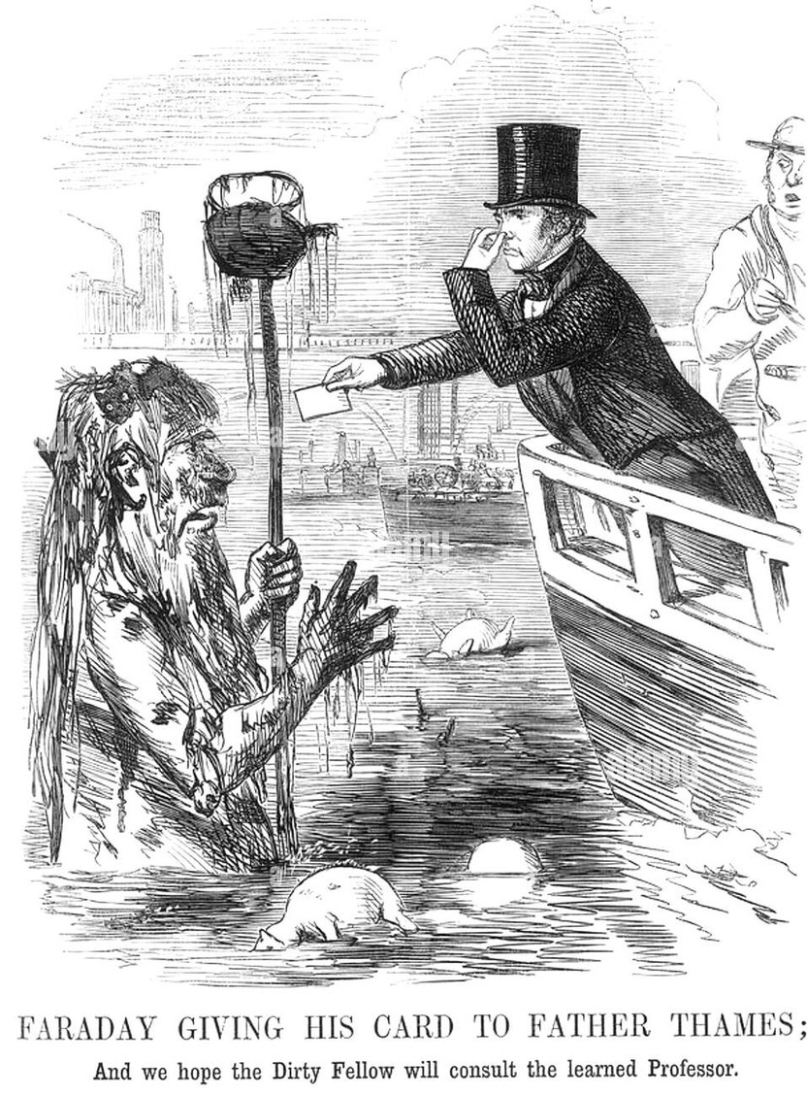
HOOK · 2 MIN
In 1957 scientists called parts of the River Thames in London “biologically dead”. Today it holds over 100 kinds of fish as well as seals! What changed?
A
A run of very wet years flushed the pollution out to sea.
B
Sewage and waste were treated before they reached the river.
C
Thousands of fish were put in, and the fish cleaned the water.
Notes:
HOOK. 2 minutes. Three cards on one click. The picture is already on the slide.
Show of hands for each, and WRITE THE TALLY ON THE BOARD. Do not settle it yet: I Do 2 does, pointing at the tally. THE HOOK STARTS FROM HOPE ON PURPOSE (the brief says not to end on damage): it is a recovery, and the lesson works out how.
ANSWER, FOR YOU: B. The Natural History Museum's scientists judged parts of the tidal Thames "biologically dead" in 1957: surveys from Kew to Gravesend, about 69 km, found no fish. From 1976 ALL the sewage entering the Thames was treated, and laws between 1961 and 1995 raised standards. The Zoological Society of London and the Natural History Museum's State of the Thames report (2021) records over 100 species of fish (115 were counted), and seals now breed in the river. The report also warns that some pressures are rising, so it is a recovery, not a cure.
A IS THE TEMPTING WRONG ONE: rain does not remove sewage, it carries more of it in; and waste kept arriving until it was treated. C IS THE "ADD SOMETHING" MISCONCEPTION, and it comes back in the We Do: fish do not clean a river; they are a sign it is clean enough. A COMMITMENT THAT IS WRONG IS CORRECTED MORE STRONGLY (PEDAGOGY.md): do not tell them. Say "write your vote".
THE PICTURE is a cartoon from Punch magazine, 21 July 1855, by John Leech: "Faraday giving his card to Father Thames". In the Great Stink summers of the 1850s the river was an open sewer. Say so, and say that by the end of the lesson they will know what fixed it.
PICTURE CREDIT: John Leech, Punch, 1855, public domain, Wikimedia Commons.

Slide 4
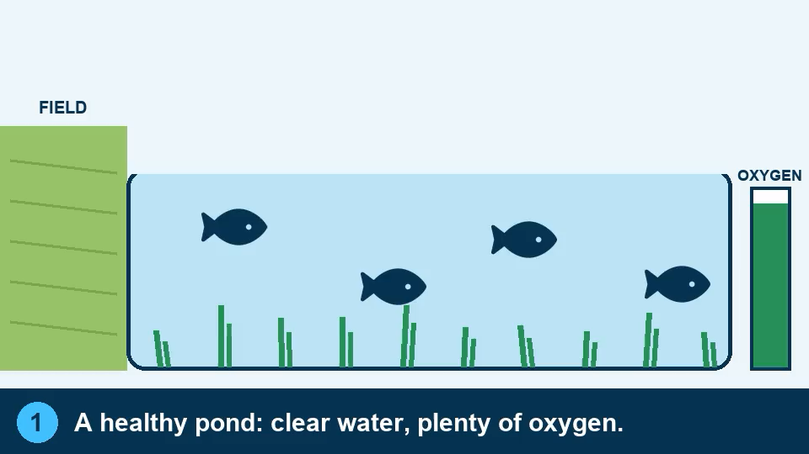
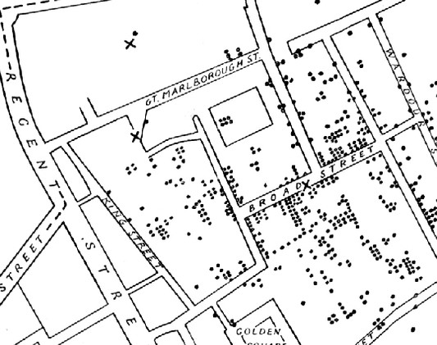
I DO · 3 MIN
What water pollution does
A Pinch Of Death
1 Fertiliser adds nutrients, so the algae multiply.
2 The algae die. Bacteria feed on them.
3 The bacteria use up the oxygen.
4 Not enough oxygen: the fish die.
ANOTHER EFFECT: DISEASE
Sewage in drinking water spreads disease. In 1854, cholera killed over 600 people near one London pump.
Too many nutrients means too little oxygen. Dirty water spreads disease.
Notes:
I DO. 3 minutes. Four clicks: the animation (ON CLICK, so say the idea first), the chain card, the disease card, then the banner.
OBJECTIVES 1 AND 2. THE ANIMATION IS A MODEL, 34 seconds, and it PAUSES at each of six steps; talk over the pauses, and click it again to replay. (1) A healthy pond, plenty of oxygen (the meter). (2) Rain washes fertiliser off the field into the pond. (3) The fertiliser feeds the algae: they multiply and the water turns green (an algal bloom). (4) The algae block the light, so the plants below die, and the algae die too. (5) Bacteria feed on the dead material and USE UP THE OXYGEN: watch the meter fall. (6) Not enough oxygen: the fish die.
THE POINT TO MAKE: THE FERTILISER DOES NOT POISON THE FISH. It feeds the algae, and it is the bacteria breathing, while they feed on the dead algae, that uses up the oxygen. This is called EUTROPHICATION (too many nutrients). Say the word, once; it is on the slide as the last frame. Same chain, from NOAA: extra nitrate and phosphate remove the limit on algal growth; when the bloom collapses, decomposers consume the dissolved oxygen; the low oxygen (hypoxia, below about 2 mg per litre) forces mobile animals out and kills the rest. Some blooms are also toxic (a different problem): leave it unless asked. Fertiliser is the nonpoint-source pollutant from last lesson: it comes off MANY fields, carried by rain. Sewage works also add phosphorus, which is a point source: both feed the same chain.
THE JARS FROM LESSON 1. If you set them up, bring them out here. Jar 2 (fertiliser added) should be greener than Jar 1, and may have a dark layer at the bottom. Do NOT open them (pond water carries germs). Take two or three of their written predictions from Lesson 1. If the jars were not set up, skip this: nothing on the slides needs them.
OBJECTIVE 2, A WORKED EXAMPLE OF "ONE OTHER EFFECT": DISEASE. Dirty water that has sewage in it carries the germs that cause cholera, typhoid and dysentery. 1854, Broad Street, Soho, London: over 600 people died in a few weeks. A doctor, John Snow, plotted every death on a map and found they clustered round one pump; the handle was taken off the pump and the outbreak ended (a leaking sewer had fouled the well). The pump is a POINT SOURCE, and finding it is easy because it is one place: last lesson's idea, used to save lives. Today, contaminated drinking water is estimated by the World Health Organization to cause about 500,000 diarrhoeal deaths a year (worksheet Q10 uses it). OTHER EFFECTS, if a student offers one: poison that builds up along a food chain (pesticides, mercury), plastic harming animals, toxic algae, closed beaches: accept any real one.
MISCONCEPTIONS. (1) "Fertiliser poisons the fish." No: it is the oxygen, three steps later. (2) "Algae make oxygen, so more algae must be good." In daylight yes; a huge bloom blocks the light, dies, and its decay uses far more than it made. (3) "A dead zone is completely lifeless." Some bacteria and hardy animals survive; it is dead for fish.
PICTURE CREDIT: the map is John Snow's cholera map (a variant of the 1854 original, drawn after Snow), public domain, Wikimedia Commons. The animation was drawn for this lesson.

Slide 5
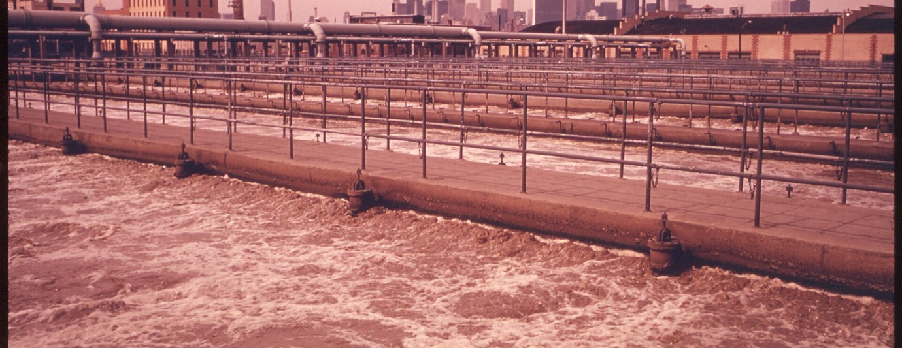
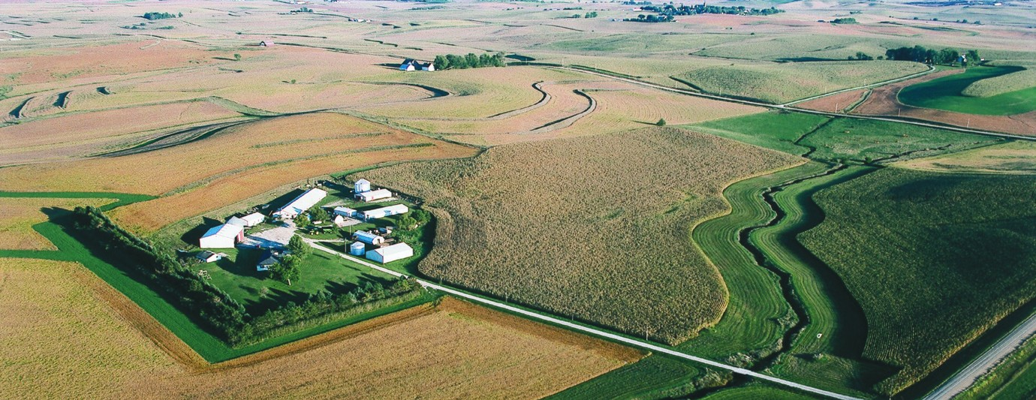
I DO · 3 MIN
Two ways to stop water pollution
1 TREAT IT AT THE PIPE
2 STOP IT WHERE IT STARTS
For POINT sources. Clean sewage and factory waste at a works before it enters the river.
For NONPOINT sources. Use less fertiliser, and plant strips of grass and trees along rivers to catch what rain washes off.
WORKED EXAMPLE London treats all its sewage. The Thames, dead in 1957, now has over 100 kinds of fish. Hook answer: B.
WORKED EXAMPLE A grass strip along a stream on an Iowa farm catches soil and fertiliser before they reach the water.
Treat what comes from pipes. Stop what comes from everywhere.
Notes:
I DO. 3 minutes. Three clicks: the pipe card, the source card, then the banner. OBJECTIVE 3, AND THE END OF THE UNIT, so go for the hope.
THE TWO THINGS ARE LAST LESSON'S TWO KINDS OF SOURCE, SO THEY ALREADY KNOW WHICH IS WHICH. (1) TREAT IT AT THE PIPE: for POINT sources there is one place, so treat what comes out before it goes in: sewage treatment works and factory waste treatment (and, of course, laws that make it compulsory). (2) STOP IT WHERE IT STARTS: for NONPOINT sources there is no pipe, so work on the land: use less fertiliser, or put it on at the right time; plant strips of grass and trees along rivers (riparian buffers) that slow the water and catch soil and fertiliser; cover bare soil. Other real answers they may give and you should accept: cleaner farming, fixing leaking septic tanks, litter pick-ups, drains that filter rain water, laws and fines, not pouring oil down drains.
SETTLE THE HOOK, POINTING AT THE TALLY: B. THE THAMES IS THE WORKED EXAMPLE FOR (1). Between the 1950s and now the river went from no fish in a 69 km stretch to over 100 kinds, because the sewage is treated: Bazalgette's sewers (built 1859 to 1875) carried it away from the drinking water and stopped cholera; treatment of ALL sewage from 1976 let the fish come back. It took about twenty years of work after the 1950s. Say "that is a river, and rivers refill in months (Lesson 1): groundwater would not have recovered in a lifetime". It is the good news the whole unit was building to. A is wrong because rain carries more sewage in, not less. C is wrong because adding fish does not remove pollution: the fish came back because the pollution stopped.
THE FARM PHOTOGRAPH (2) is a grass filter strip planted along a stream on a farm in Carroll County, Iowa. It does not clean a whole river by itself, but it is the kind of thing that works on a nonpoint source, because it can be done on every farm. Be honest: it needs many people, which is why last lesson said nonpoint pollution is harder. The point is that it CAN be done.
MISCONCEPTIONS. (1) "Once polluted, always polluted." The Thames. (2) "Add chemicals or fish to clean it": removing the source works; adding things does not. (3) "Treating sewage fixes everything": it fixes the pipe, not the farms.
PICTURE CREDITS. Sewage works: aeration tanks at the Newtown Creek sewage treatment plant, Brooklyn, April 1974, Hope Alexander for the US Environmental Protection Agency (Documerica), public domain. Grass strip: Lynn Betts, USDA Natural Resources Conservation Service, public domain. Both from Wikimedia Commons.

Slide 6
WE DO · 5 MIN
Rank and conquer
Four answers to one question. Which is the weakest? Which is the strongest?
Describe how fertiliser running into a river leads to fish dying. [4 marks]
A
B
Fertiliser adds nutrients, so algae grow very fast. When the algae die, bacteria feed on them and use up the oxygen in the water. With too little oxygen, the fish die.
Fertiliser makes the algae grow and the water turns green. After that the fish die.
3rd · 1 mark Only the algae. It never says why the fish die.
1st · 4 marks Every step: algae, dying, bacteria, oxygen, fish.
C
C
Fertiliser adds nutrients, so algae grow very fast. When the algae die, bacteria feed on them and use up the oxygen. With too little oxygen, the fish die.
D
Fertiliser is a poison. It dissolves in the water and the fish swallow it and die.
Fertiliser makes the algae grow fast. Then the algae die. The oxygen runs out and the fish die.
4th · 0 marks A wrong idea: fertiliser feeds algae, it is not the poison.
2nd · 3 marks A step is missing: why does the oxygen run out?
UPGRADED · 4 marks The poison idea is gone. The chain is in.
Notes:
WE DO. 5 minutes. Five clicks: the four ranks (weakest first), then the upgrade. THE MODE IS "RANK AND CONQUER" (TEMPLATE.md): four answers to one exam-style question, written to differ in quality in known ways. The last We Do (What's The Point) was "Finish this one", so TEMPLATE.md says to rotate. It is the right mode for a "describe" objective: it needs reasons from the room, not words.
THE RANKING COMES FROM THE MARK SCHEME, NOT TASTE. The question is out of 4. ONE MARK EACH FOR: (1) fertiliser adds nutrients so the algae grow fast; (2) the algae die; (3) bacteria feed on the dead algae and use up the oxygen; (4) with too little oxygen the fish die. THE COUNTS: B has all four = 4 marks (1st). D has (1), (2) and (4) but not (3): it says the oxygen "runs out" but never says why = 3 marks (2nd). A has (1) only: it says the water turns green and the fish die, and never connects them = 1 mark (3rd). C has none: "fertiliser is a poison" is a wrong idea = 0 marks (4th).
RANK. Read the four out. THE CLASS COMMITS BY A SHOW OF HANDS: who thinks the WEAKEST is A, B, C or D? Then the STRONGEST? Write the tallies. Then CLICK: the slide reveals the ranking from the bottom up, one card at a time, each with ONE reason (the 4th, then the 3rd, the 2nd and the 1st). Ask "what did the person writing C forget?" and "what is the one step missing from D?" (why the oxygen runs out: bacteria). Ask a student to point at the step in the animation.
CONQUER. C HOLDS THE LESSON'S MAIN MISCONCEPTION (the fertiliser poisons the fish). TAKE IT AND UPGRADE IT TOGETHER until it would rank first: ask for the missing steps in order (what does the fertiliser actually do? then what happens to the algae? what feeds on them? what does that use up?), build the answer aloud, and only then click: THE UPGRADED ANSWER IS THE LAST CLICK, and it would score 4.
IF THEY ARE QUICK, ask "which one extra thing could a 5th mark be for?" (the algae blocking the light so the plants die). IF SHORT OF TIME, skip the hands for the strongest and do the ranking and the upgrade.

Slide 7
COLD CALL · 6 MIN
Put in order: bacteria use up the oxygen, algae die, algae multiply, fish die.
Describe one effect of water pollution, other than harm to fish.
1
2
The algae multiply, the algae die, the bacteria use up the oxygen, the fish die.
Dirty water spreads disease, such as cholera, to people who drink it.
Describe two things that reduce water pollution.
Explain why a strip of grass along a river helps.
3
4
Treat sewage and waste at the pipe. Use less fertiliser or plant strips along rivers.
It catches the fertiliser and soil that rain washes off the field before they reach the water.
An aquifer holds 400 billion litres. Wells take 25 billion a year and rain adds 5 billion. Find the years until it is empty.
Explain why a polluted river can recover faster than polluted deep groundwater.
5
6
400 ÷ (25 − 5) = 20 years
A river refills in months. Deep groundwater takes thousands of years to flush out.
Notes:
COLD CALL. 6 minutes. Six clicks. Name a student, then ask: thinking time first, no hands up, no whiteboards. If a student cannot answer, take it elsewhere and come back to them to repeat it.
TWO OF THE SIX ARE FROM EARLIER LESSONS (TEMPLATE.md): Q5 (the aquifer net loss, Finite Freshwater: out minus in, then divide: new numbers) and Q6 (how fast water is renewed, Lesson 1: a river in months, deep groundwater in thousands of years). Q6 is the good-news answer to the unit: rivers recover; deep groundwater would not.
Q1 IS OBJECTIVE 1 AS A SEQUENCE: any wrong order shows which step they have lost; "bacteria use up the oxygen" must come after "the algae die". Q2 IS OBJECTIVE 2: any real effect is acceptable (the lesson used disease). Q3 IS OBJECTIVE 3 and needs TWO DIFFERENT things (not "treat sewage" and "treat factory waste", which are the same idea: at the pipe). Q4 IS THE REASON FOR THE SECOND ONE: it catches what rain washes off. Q5: the working first, then the answer and unit: 25 − 5 = 20 billion a year net loss, 400 ÷ 20 = 20 years. If a student divides 400 by 25, ask "is the rain not adding water?".
IF MOST OF THE ROOM IS RIGHT BY Q4, ask "what would a town need to do for a river that has fertiliser coming from fields all around it?" (nothing at one pipe: plant strips, less fertiliser). IF SHORT OF TIME, cut Q6.

Slide 8

YOU DO · 14 MIN
Pollution Pandemic worksheet
Open Google Classroom now.
BRONZE
SILVER
GOLD
The chain, and disease
Why, and how it is stopped
Write it, and the Thames
Describe how fertiliser leads to dead fish, put the steps in order, and name an effect on people. Read the worked example first.
Explain the chain, say how a works and a grass strip each reduce pollution, and work out a number from real data.
Write your own four-mark answer, match each fix to its source, and use the Thames to say why a polluted river can recover.
Choose a tier. In each one read the worked example, finish the half-worked one, then do your own. The questions are mixed on purpose.
Notes:
YOU DO. 14 minutes, then 3 to mark (the next slide). Four clicks: the three tiers, then the note. THE WORKSHEET IS THE TASK. There is no game today (the brief has no GAME line; one can be built if you want it).
THREE TIERS, THEY CHOOSE (TEMPLATE.md). BRONZE: a worked description of the chain, a half-worked one (four blanks), the six steps in order, a photograph of a dead fish in an algae-choked river (Q3), an effect on people, and two ways to cut pollution. SILVER: why the bacteria use up the oxygen (Q6, "why does that step work?"), why fertiliser is not a poison (Q7), how a works and a grass strip each work (Q8, Q9), and a number from real data: about 500,000 deaths a year from contaminated drinking water is about 1,370 a day (Q10). GOLD: a full four-mark answer from memory (Q11, the We Do), matching each fix to the kind of source (Q12), "where would you meet this outside the lesson?" (Q13) and the Thames (Q14), which is the unit's closing question. AIM FOR ABOUT FOUR RIGHT OUT OF FIVE on Bronze: if Bronze is producing lots of errors, the problem is the I Do, not the student.
THE QUESTIONS ARE MIXED ON PURPOSE (interleaved): a sequence, a description, a number. The sheet says so. THE WORST MISTAKES TO LOOK FOR: "the fertiliser poisons the fish" (Q3, Q7); the chain with the bacteria missing (Q1, Q11); and, in Q10, dividing the other way (365 ÷ 500,000). THE WORKSHEET HAS A RAG GRID at the top: students colour the start column now and the end column at the end. Answers are printed UPSIDE DOWN on the last page.
CIRCULATE WITH ONE QUESTION: "what uses up the oxygen?" AT THE END OF 14 MINUTES, stop them and go straight to the Mark slide. It does not get absorbed into the You Do.

Slide 9
MARK · 3 MIN
Turn to the back. Mark your own in a different colour.
CHECK YOUR WORK AGAINST THIS
The chain: nutrients, algae multiply, algae die, bacteria use up the oxygen, fish die.
Fertiliser does not poison the fish. It feeds the algae.
Another effect: dirty water spreads disease.
Two fixes: treat it at the pipe, and stop it where it starts.
Write the correct answer next to anything wrong. Do not rub it out.
Notes:
MARK. 3 minutes. One click: the checklist. THE INSTRUCTION ON THE SLIDE IS "Turn to the back. Mark your own in a different colour." (TEMPLATE.md). This phase is not optional and is not absorbed into the You Do: marking straight after doing is a retrieval event and a feedback event at once.
THE ANSWERS ARE PRINTED UPSIDE DOWN at the foot of the last worksheet page. Q1 is algae, die, oxygen, fish; Q2 is 1 to 6 in the animation's order; Q10 is 500,000 ÷ 365 = about 1,370 a day. The rest are in words, so check the KEY IDEAS (nutrients feed algae; the algae die; bacteria use up the oxygen; the fish die from too little oxygen; disease; treat at the pipe; stop it where it starts).
WALK ROUND for the three commonest mistakes: "the fertiliser poisons the fish" (the chain with no oxygen in it); the bacteria left out (the Do Now answer and the We Do answer D); and two fixes that are really one (treating sewage and treating factory waste are both "at the pipe"; they need one from the land as well).

Slide 10
PLENARY · 3 MIN
True or false?
Fertiliser kills fish by poisoning them directly.
FALSE
When algae die, bacteria feed on them and use up the oxygen in the water.
TRUE
Dirty water can spread diseases such as cholera.
TRUE
Treating sewage at a works is enough to stop all water pollution.
FALSE
A farmer plants a strip of grass between a field and a river. Less fertiliser should reach the river.
TRUE
A river once called dead now holds over 100 kinds of fish. Pollution can be stopped.
Notes:
PLENARY. 3 minutes. Eleven clicks: each statement, then its answer, then the closing line.
EVERY FALSE IS A MISCONCEPTION FROM TODAY. Q1: the poison idea (the We Do's answer C): fertiliser feeds the algae, and the fish die of too little oxygen (objective 1). Q4: treating sewage fixes the PIPES; farms, roads and gardens are nonpoint and need the second fix (objective 3, and last lesson's point against nonpoint). Q2 and Q3 are plainly TRUE (objectives 1 and 2). Q5 IS THE APPLIED ITEM (TEMPLATE.md asks for at least one): a grass strip catches fertiliser and soil, so less reaches the river. Ask "which of the two fixes is that?" (stop it where it starts).
SETTLE THE HOOK, POINTING AT THE TALLY, if you have not: B (the sewage and waste were treated).
THIS CLOSES THE UNIT, AND THE BRIEF SAYS NOT TO END ON DAMAGE, SO THE LAST LINE IS THE GOOD NEWS: a river once called dead now holds over 100 kinds of fish, and pollution can be stopped. WHAT THE UNIT ADDED UP TO (TEMPLATE.md asks for it): there is very little fresh water people can use (Lesson 1); a renewable store can still run short, and it is about where and when (Finite Freshwater); water becomes unusable by pollution, from one place or from everywhere (What's The Point); and pollution does harm, but it can be stopped, at the pipe and where it starts (today). Say it in those four sentences if there is a moment.
THE JARS: if you have them, finish by looking at them once more and asking what each one would need to be clean again.

